Slide 1
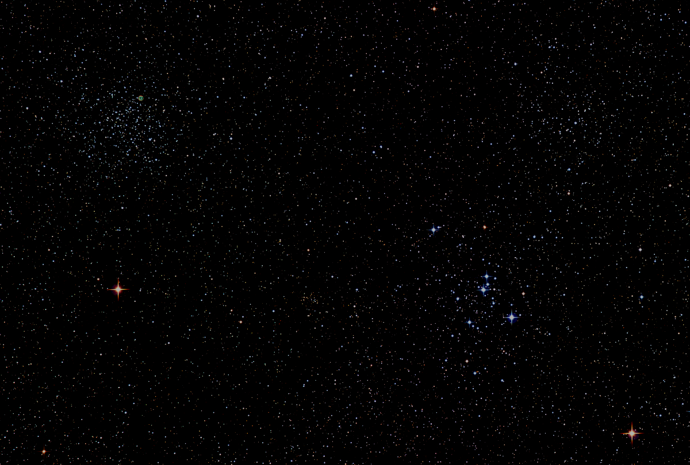

Howard
Astronomical
League
17
August 17th, 2017

Slide 2
Thank You!
Mike Krauss and
Chas Rimpo
Notes:
Hosting the June and July meetings.

Slide 3
Introductions

Slide 4
Big Announcement!
Bob Prokop
HAL Observing Chair www.howardastro.org
Home → Resources → Observing Reports
Notes:
Thanks, Bob for accepting this post. Thank you, again, Chas Rimpo for bringing the idea to the board, and setting up the blog.

Slide 5

Upcoming Events
The Great American Eclipse
August 21, 2017

Slide 6
HAL Community Eclipse Experience Project
Heads up!!
I hope to capture the extended HAL community's (all subscribers to howardastro@yahoogroups.com) solar eclipse experience, and present this experience at the September monthly meeting. Shortly after the eclipse, I will send out a call for photos, sketches, narratives, or anything else that eclipse viewers would like to contribute to this project. Please be thinking about what you would like to capture and share as the eclipse is just a few days away.

Slide 7
Upcoming Events
HAL Events
Aug 19th at 8pm– Members’ Star Party, Alpha Ridge
Aug 26th at 7:30pm – Public Star Party, Alpha Ridge
Sept 16th at 7pm – Members’ Star Party, Alpha Ridge
Regional Events
Sept 21-28 – Black Forest, Cherry Springs, PA Star Party

Slide 8
Guest Speaker
Dr Bindu Rani
NASA Post Doctoral Fellow at Goddard Space Flight Center
Wobbling Jets in Active Super-Massive Black Holes.
Notes:
It is my distinct pleasure to introduce Dr. Bindu Rani. She has been a Postdoctoral Fellow at NASA/Goddard Space Flight Center since July 2016, and will continue to hold that post until June 2019. She was also a Postdoctoral Fellow at the Max-Planck-Institut für Radioastronomie Bonn, Germany from February 2014 to June 2016. She has held visiting scientist and researcher positions at the Korean Very Long Baseline Interferometry Network of the Korea Astronomy and Space Science Institute, and The Gra-dig-nan Bordeaux Nuclear Research Center in France. Dr. Rani has experience in Gamma-ray, X-ray, optical, and radio astronomy. Her optical observational experience includes use of the 1.04 meter telescope at AIRES, Na-in-i-tal, India, and the 1.20 meter telescope at Mount Abu, India.
Among her many achievements, Dr. Rani was awarded the Otto Hahn Medal for outstanding scientific achievements by the Max Planck Society in 2015. She holds Bachelor and Master of Science degrees from University of Delhi and Da-yan-and University, respectively, in India. Last, and certainly not least, Dr. Rani completed her Ph.D at Max-Planck-Institut für Radioastronomie and University of Köln, both in Germany in 2013.

Slide 9
Member’s astrophotos
and sketches

Slide 10
Victor Sanchez
Welcome Back from Tanzania!

Slide 11
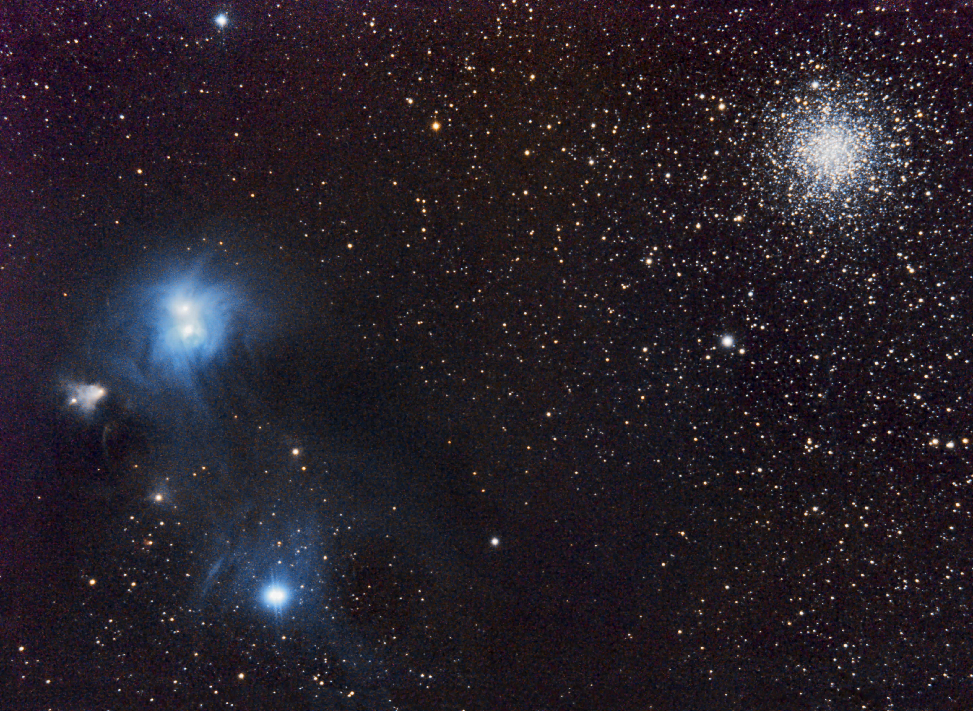
Victor Sanchez
NGC6729

Slide 12
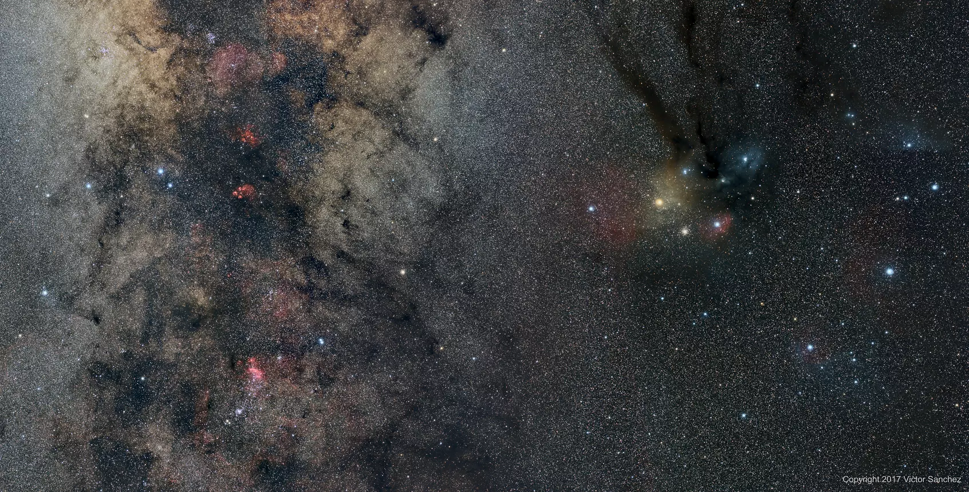
Victor Sanchez
Scorpio Mosaic
Submitted to APOD?

Slide 13
Thank You!
Next month’s meeting is on Thursday, September 21st, 2017 at 7 PM
Jim Johnson
The HAL Community Eclipse Experience

